Slide 1
introduce myself
ISLAM ASADUL
20192902011
DEPARTMENT: CST-19
WUXI UNIVERSITY

Slide 2
Introduction
HOTEL & RESORT PROJECT was developed following system development stages for smooth running and management of MAJESTIC HOTEL & RESORT. The system was carefully designed to ensure the maximum efficiency of the system at the hotel. The system was skillfully and carefully coded to seal any possible loopholes in the system. The system was developed using visual basic language like HTML, CSS & JS. This system will indeed help the hotel management and the esteemed staff members to manage and steer the hotel’s functionality and transactions to realize its maximum potential in addition to its competence in the hotel business field. The system Provides 5 Pages like Home Page, Explore Page, Rooms Page, Booking Page, and Contact Page. There have also a booking system for booking tickets. There have Contact information on every page on the right top side for Customers.

Slide 3
Objective/Goal of this project:
The goal of this project is very simple. We need to develop a website, what we learned this semester based on.
To create a responsive, interactive website.
There will be 5 pages linked to each other
There will a booking form validated by JS.
Beautifully Designed
User handily
A reservation forms including button

Slide 4
System Requirement:
To create this website need some information, Address, logo, and images. I coded on visual code editor and opened it on Google Chrome browser. I linked a website in the index.html file to beautify font style.

Slide 5
Planning:
The logo of the Hotel will be on the top side of the home page in the middle. Then navigation bar will be underneath the logo. Every page will be interlinked. Then in the body part will be designed:
Pictures with popup description
Then a horizontal menu.
Then services
Review options
Reservation button
And footer with about us and copyright message.
Explore page will be the same.
The room page will be pictured with a popup description; price, category, etc.
Booking page including a form.
Contact page with responsive contact forms.

Slide 6
Analysis and Implementation
At first, I create an index.html file to edit codes. In this index file, I wrote HTML code according to information about MAJESTIC HOTEL & RESTAURANT. In the div tag, I took a header to insert a logo and an unordered list to create a navbar with a tag. Then next section I put some pictures in the img tag with a description. Then we have a horizontal picture with a linking description. If you click this description link then you can easily go and visit our hoom page. Then next we have some services information with icons. I invoked these icons as a picture logo. Then I have taken a button tag to put there a reservation button. Then we have review options. Now at the end, we have a footer including address and social media icons

Slide 7
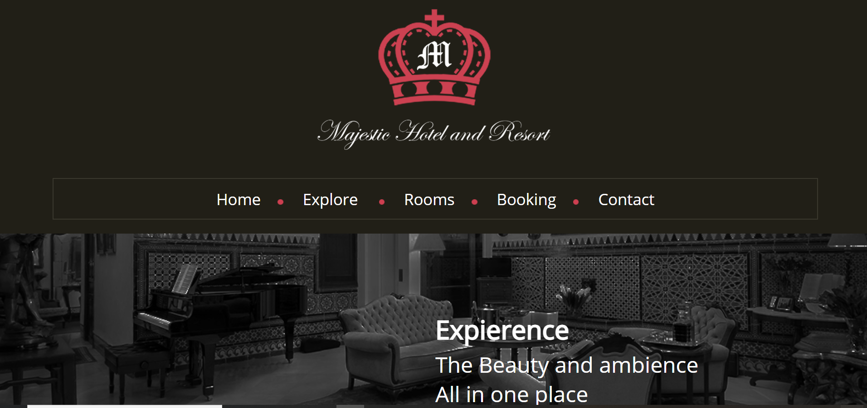

Slide 8
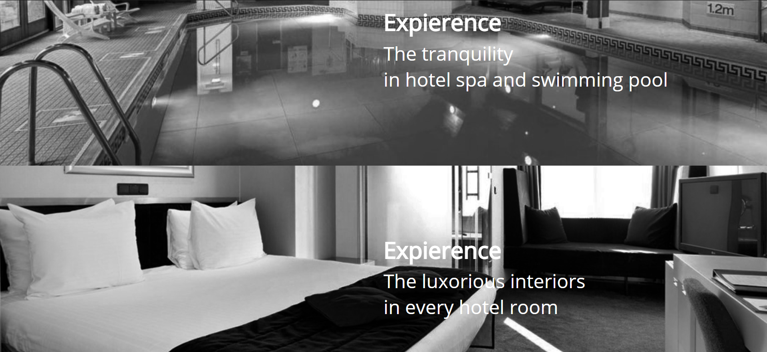

Slide 9
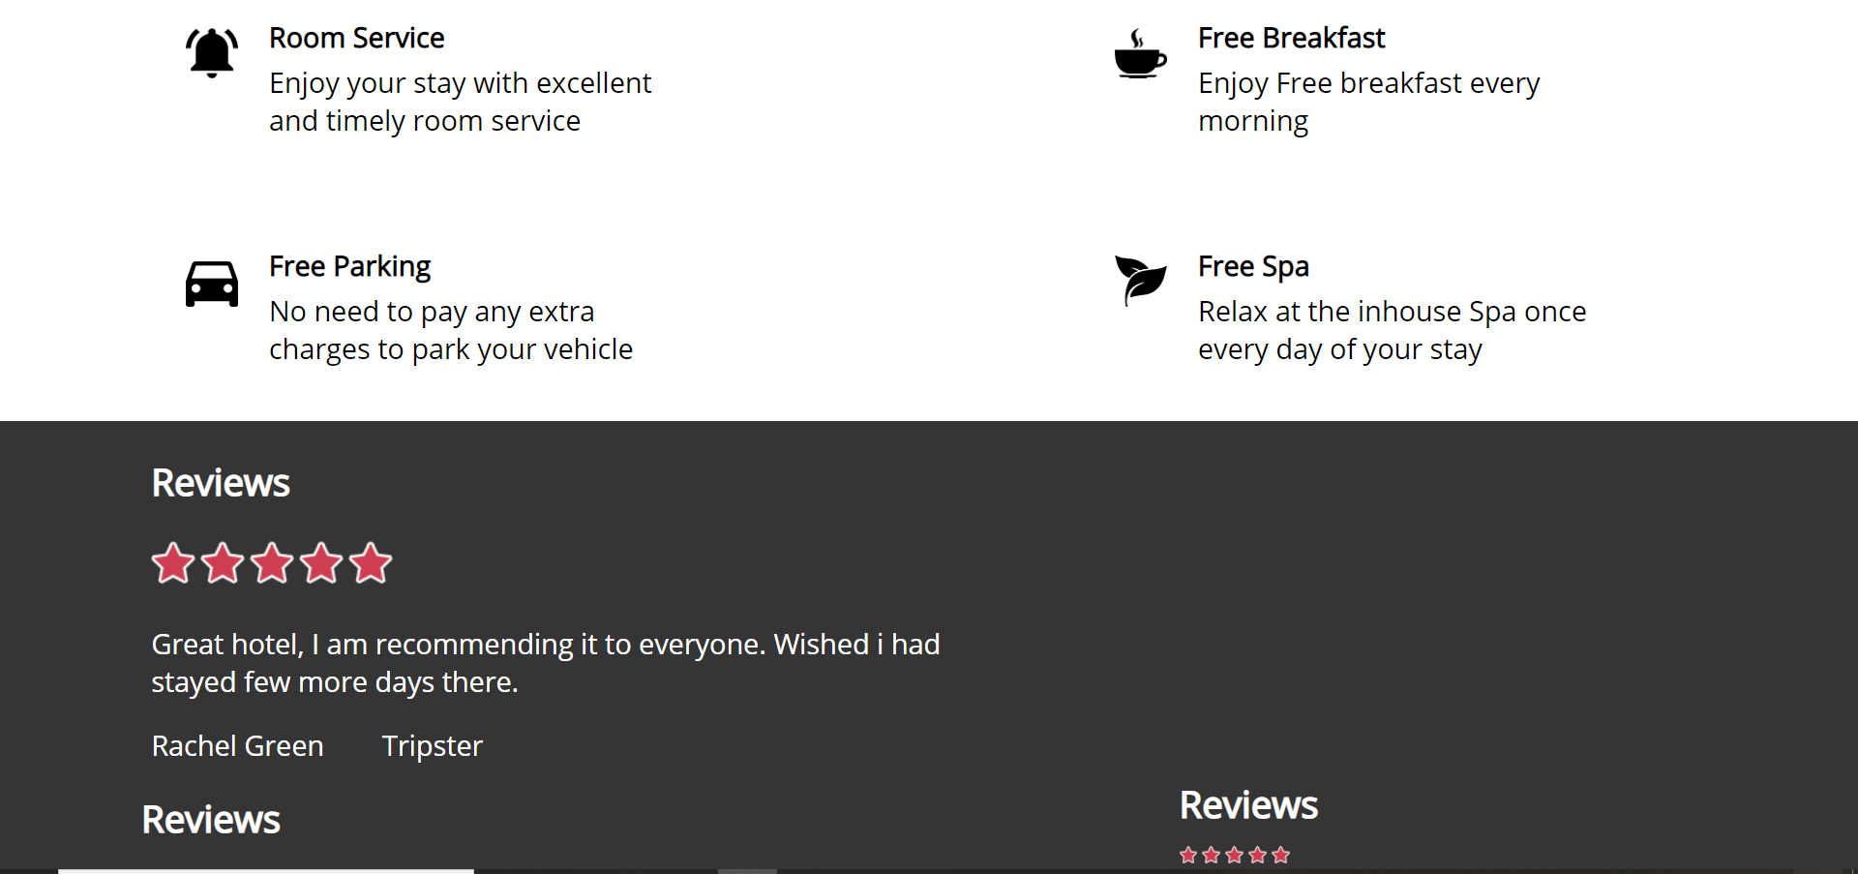

Slide 10
exploring page
To implement all the information correctly and design it I have divided into section and took div. I opened the external CSS file name main.css and slick.css to beautify and positioning the HTML element. In the explore page I insert some information in the div tag and img tag with a brief description about our Hotel & Resort . I invoked an external JS file to make it pop up. There is a demo.js file, I used simple Jquery and function to make it pop up. Later I invoked this external JS file in the head of the exploring page.

Slide 11
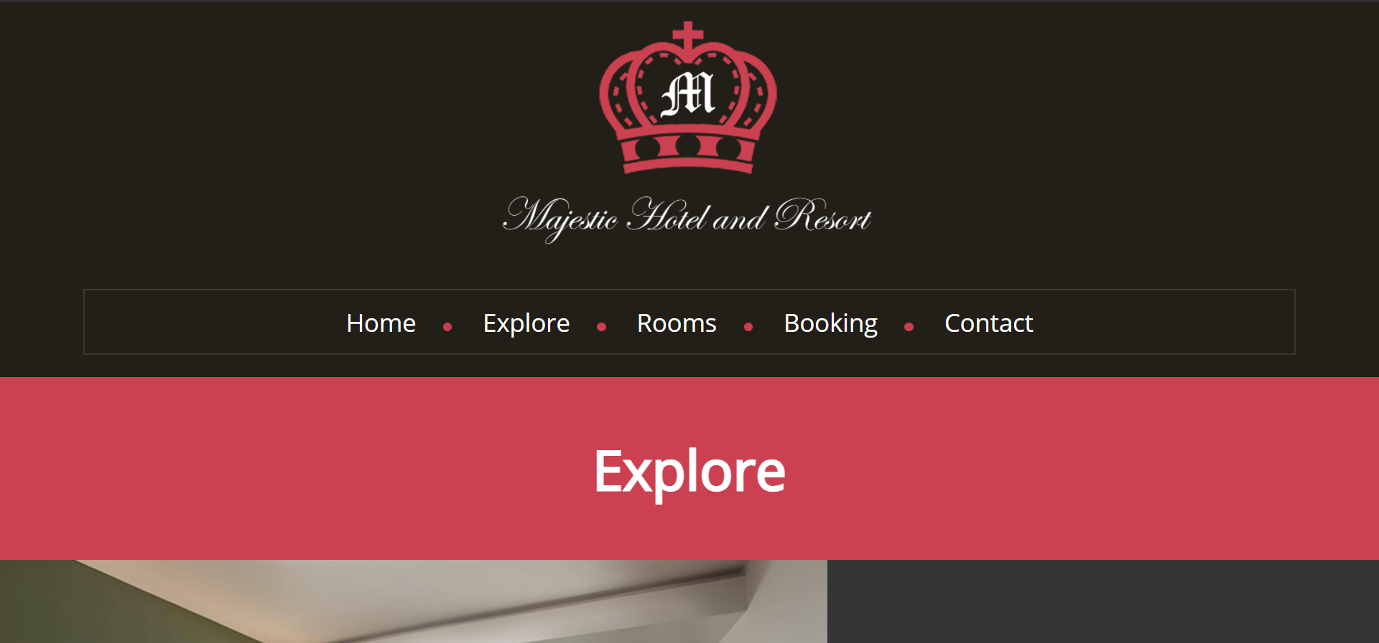

Slide 12
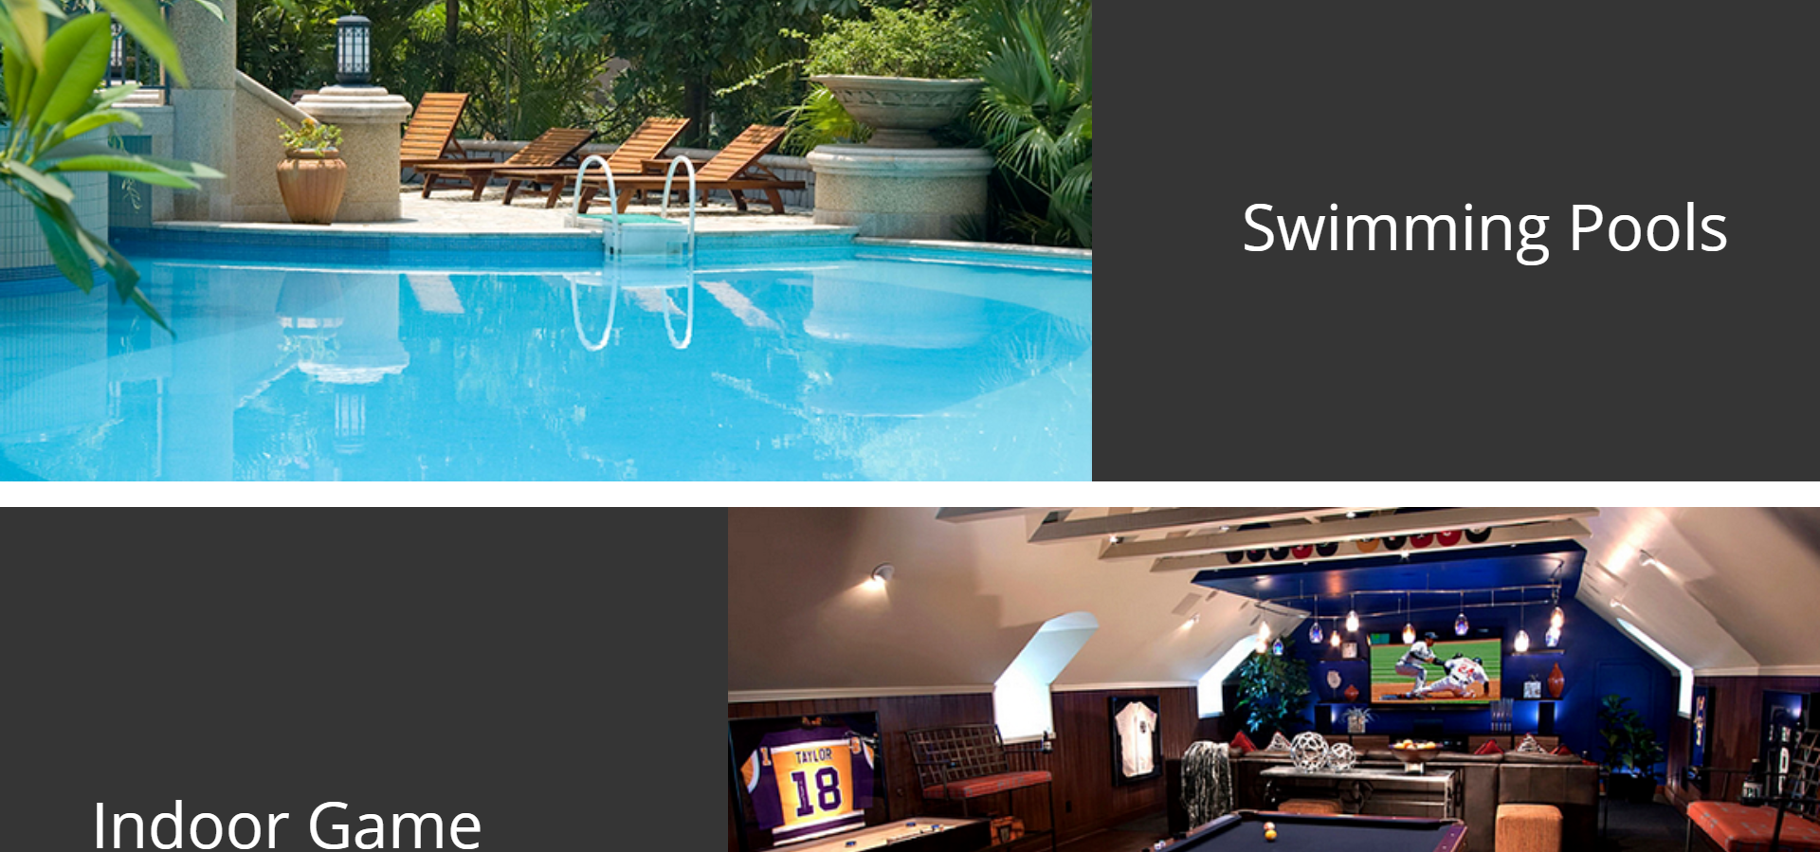

Slide 13
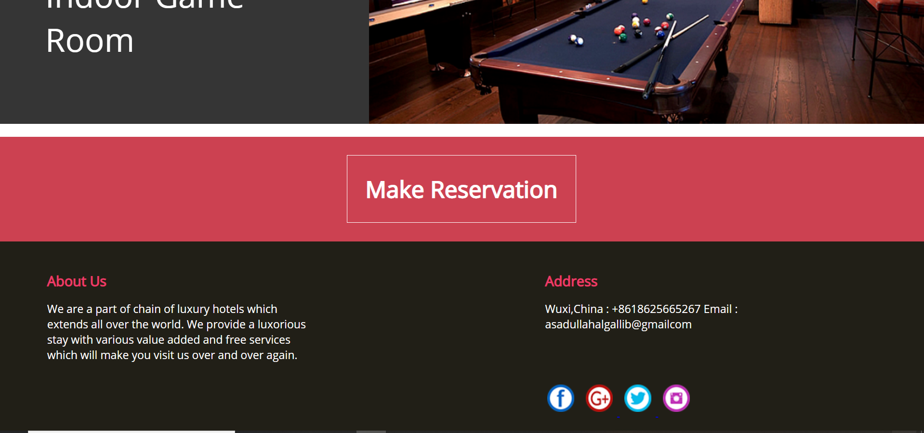

Slide 14
room page
On the rooms page, you can see some pictures of our rooms with a popup description with price information. When you touch the cursor then the popup description will be shown

Slide 15
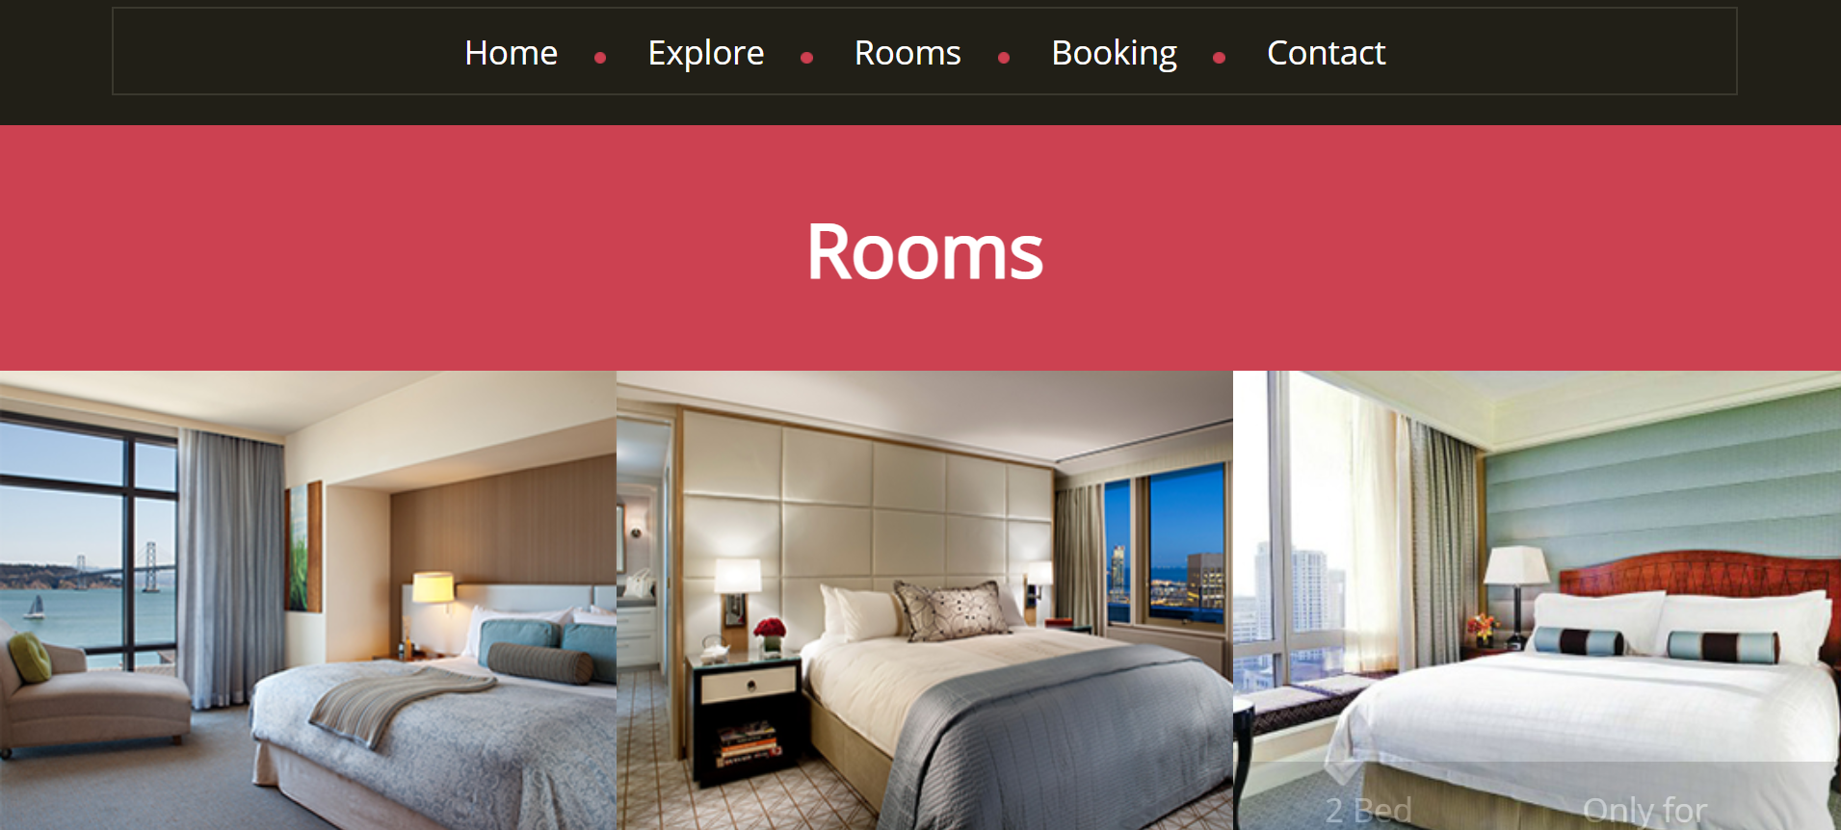

Slide 16
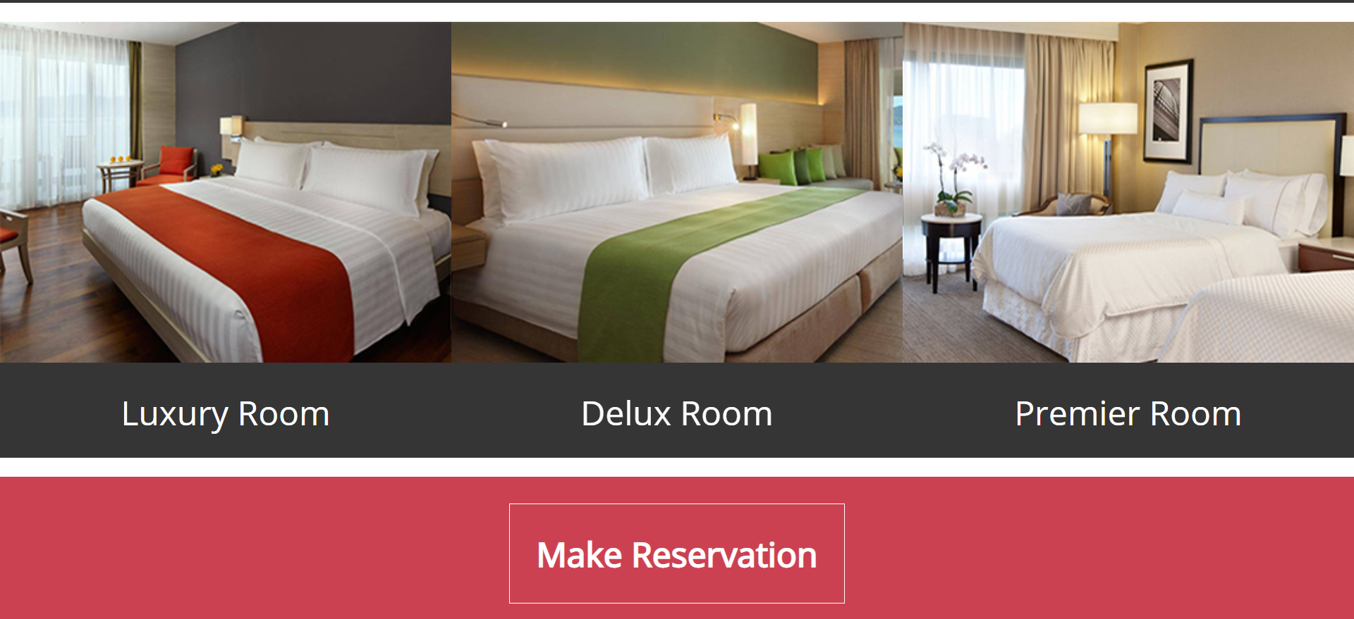

Slide 17
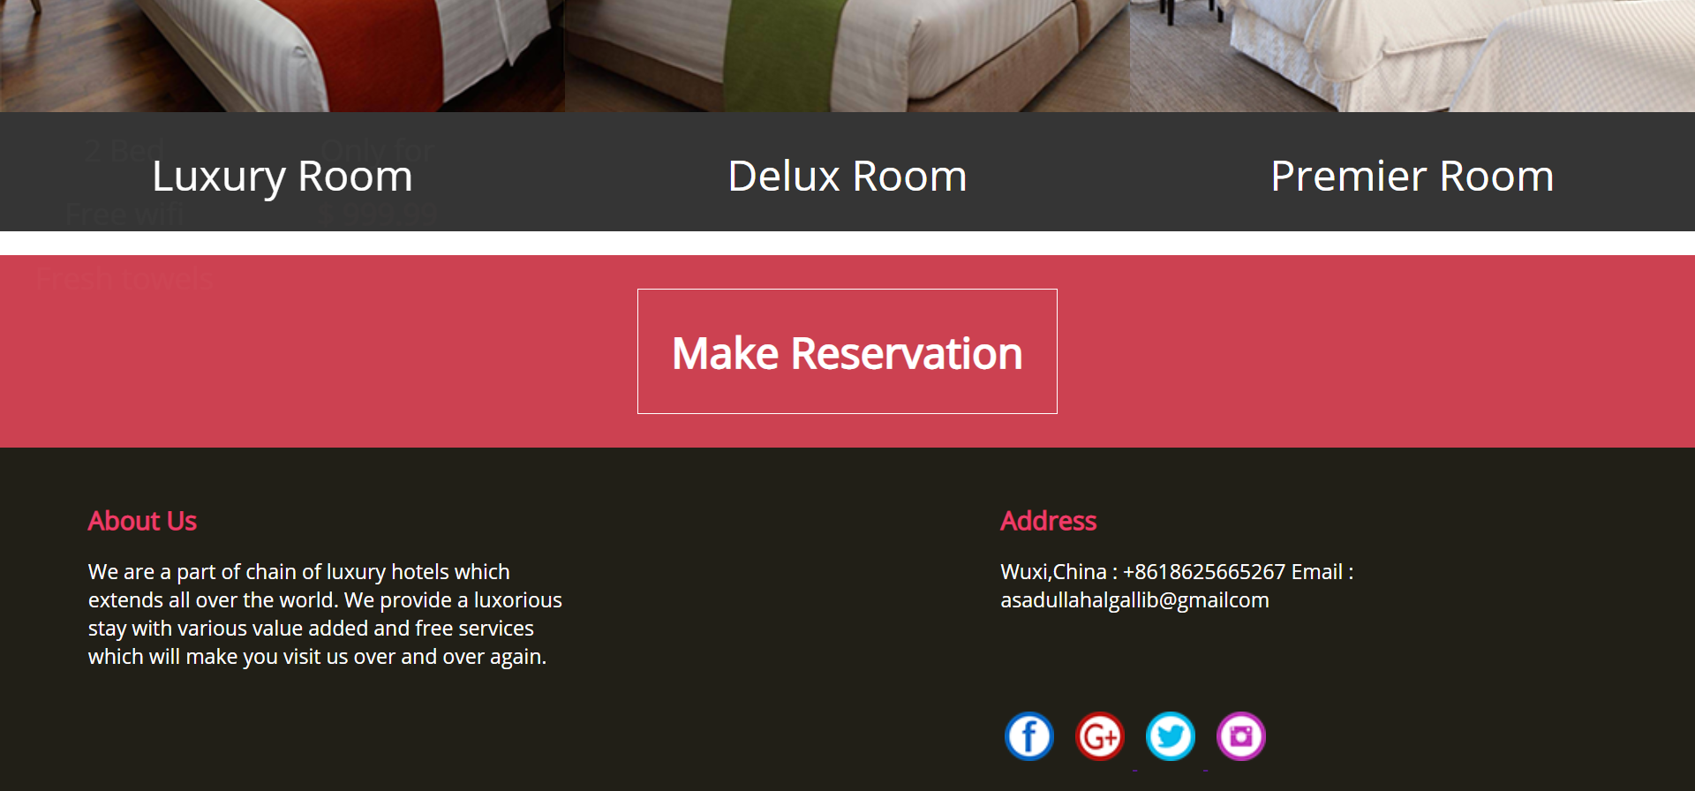

Slide 18
booking page
On the booking page, I have taken a form tags to create a reservation form. In the form, I have taken an input tag to input information and a button tag to proceed. I linked an external JS file to validate this form

Slide 19
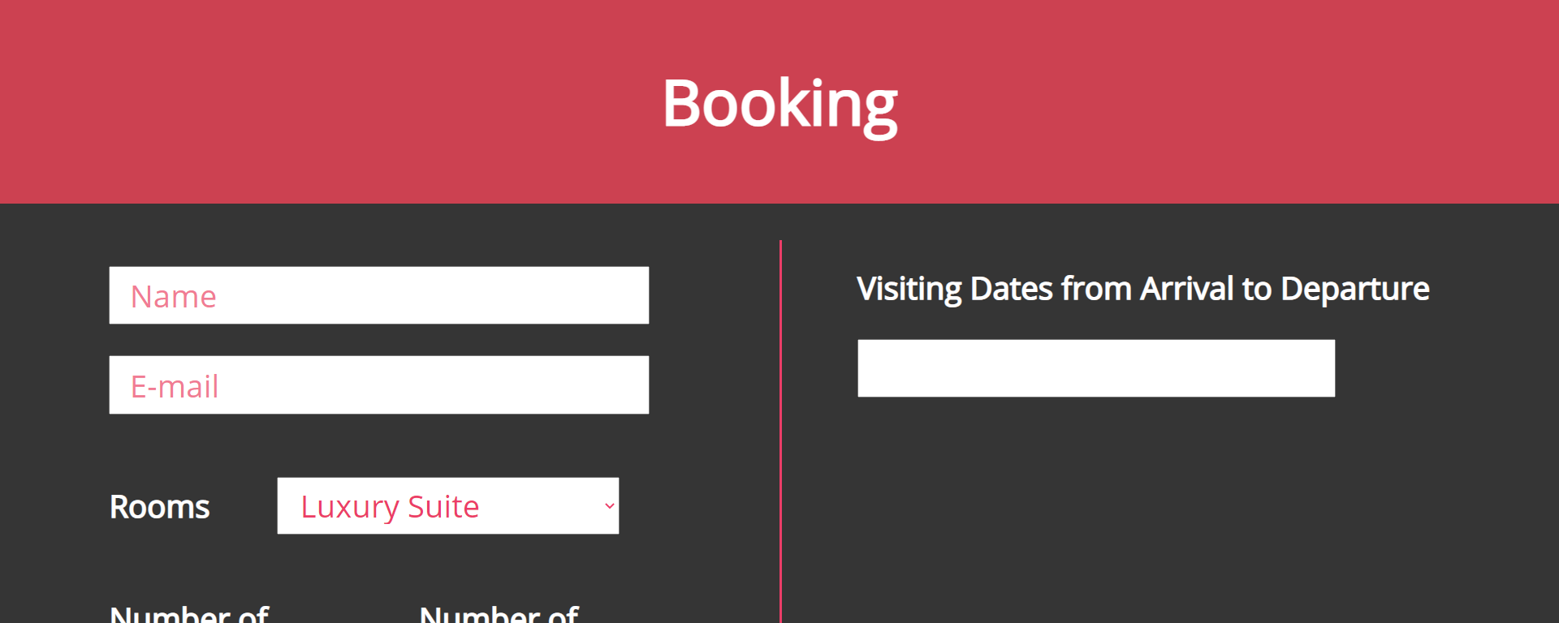

Slide 20
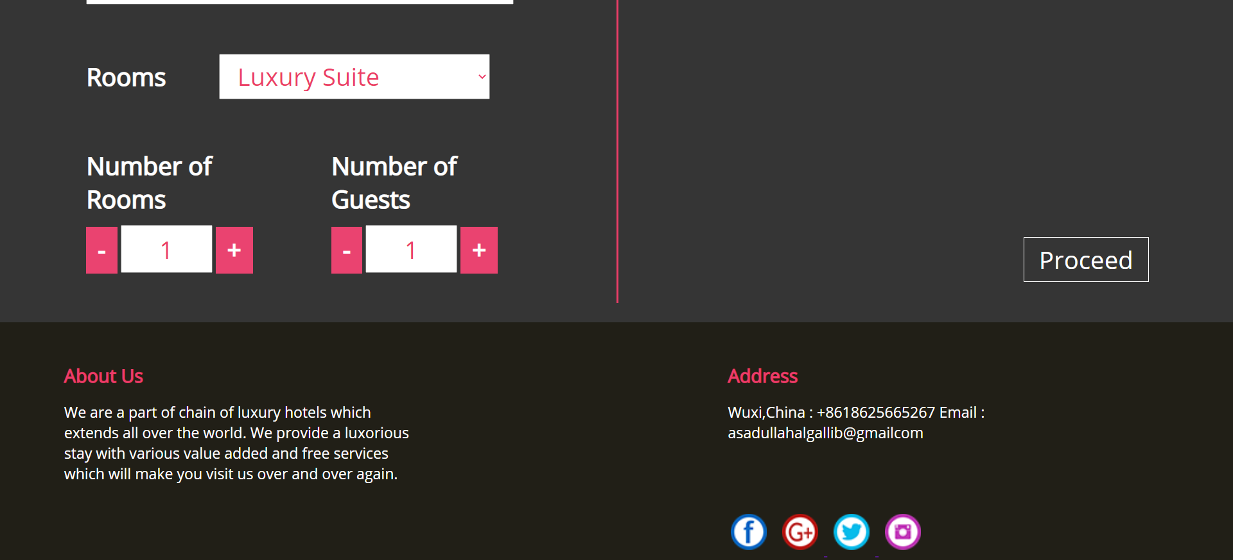

Slide 21
contact page
On the contact page, there has a form to input value to contact with us and a send message button. Besides I put a map of our location.

Slide 22
